Slide 1

Artificial Intelligence-Enabled Surveillance of Knee Osteoarthritis Through Gait Analysis Project Category: Research
PROJECT REVIEW - 3
Guide: | Student Name & Registration Number:
Dr. S. Karthick | Mr. Karthik B – RA2112701010014
 | Mr. Udhaya M – RA2112701010021

Slide 2
OBJECTIVE
Develop an AI-Based Gait Analysis Model
Implement computer vision and deep learning algorithms to extract movement features from video data.
Detect Post-Surgical Abnormalities and Deviations
Identify gait deviations, improper joint mobility, weight distribution issues, and other complications.
Automate the Post-Operative Assessment Process
Generate reports with key recovery metrics

Slide 3
DATASET OVERVIEW
The KOA-NM dataset is designed for Knee Osteoarthritis (KOA) detection using gait analysis.
It contains video recordings of individuals categorized based on KOA severity levels.
A set of 6 red-colored passive reflective markers has been attached to the subject’s body joints.
The dataset is collected using a single NIKON DSLR 5300 camera placed 8m away from the walking mat.
Videos are in .MOV format
KOA-NM Dataset consists of gait videos classified into four categories:
NM (Normal Movement)
KOA_EL (Easy KOA)
KOA_MD (Moderate KOA)
KOA_SV (Severe KOA)

Slide 4
PRE PROCESSING
Video Format Conversion
Converted .MOV files to .MP4 for compatibility.
Frame Extraction
Extracted frames from videos at a uniform FPS (Frames Per Second).
Noise Reduction & Enhancement
Applied Gaussian Blur and contrast enhancement for better feature extraction.
Pose Estimation
Used Mediapipe to extract joint movement key-points.
Key-Points Detection
Identify the maker placed in joints of subject and store.
Data Augmentation
Introduced rotation, flipping, and brightness variations to improve model generalization.

Slide 5
PRE PROCESSING
Challenges:
Unreadable .MOV files
Inconsistent FPS
Blurred frames
Missing joint key-points
Solutions:
Converted to .MP4
Standardized to fixed FPS
Applied sharpening & noise reduction
Improved pose estimation accuracy

Slide 6
FEATURE EXTRACTION
Input Data:
MOV format videos of patients walking from left to right (side view) across an 8-meter distance in front of a fixed camera.
Pose Estimation with MediaPipe:
Extracts key body landmarks per frame:(x, y, z, visibility) for each joint.
Emphasis on lower-body joints (hip, knee, ankle) to assess replacement recovery.

Slide 7
FEATURE EXTRACTION
Preprocessing Steps:
Convert video to frames (e.g., 30 fps).Normalize and resize frames for uniformity.
Side view improves joint movement visibility during gait cycle.
Data Structuring:
Landmark data arranged as time series sequences:
Format: (frames, joints, features)
Example: 300 frames × 33 joints × 4 features
Padding/truncation applied for fixed sequence length.

Slide 8
Model Architecture
Architecture
Feature Extraction (CNNs) – Extracts spatial features from each frame.
LSTM Layer – Captures temporal dependencies in gait patterns.
Fully Connected Layer – Classifies severity levels of KOA.
LSTM for KOA Detection
Handles sequential gait data effectively.
Remembers long-term dependencies in walking patterns.
Outperforms traditional CNNs in analysing movement over time.
Improves KOA severity classification by learning time-series variations in gait

Slide 9
Model Training
Model Training & Validation
Dataset: KOA-NM (Train, Validation, Test splits).
Loss Function: Categorical Cross-Entropy.
Optimizer: Adam for efficient learning.
Performance Metrics: Accuracy, Precision, Recall, F1-score.
Expected Outcomes
Early detection of KOA severity levels.
Automated gait analysis for doctors.
Improved patient diagnosis & treatment planning.

Slide 10
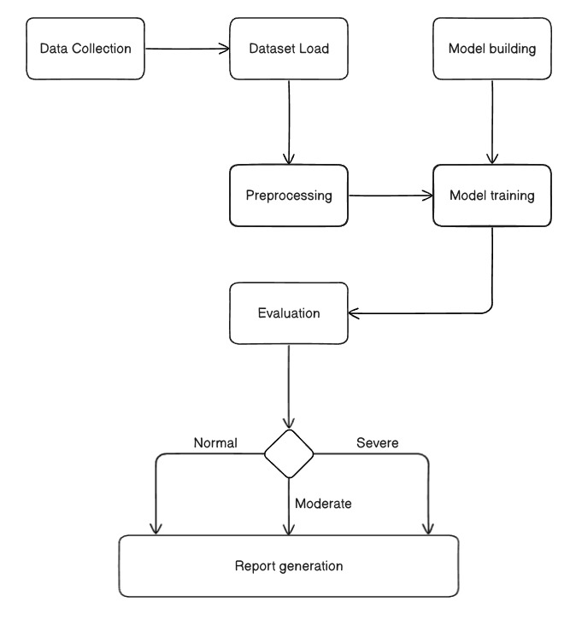
Architecture Diagram
Classification

Slide 11
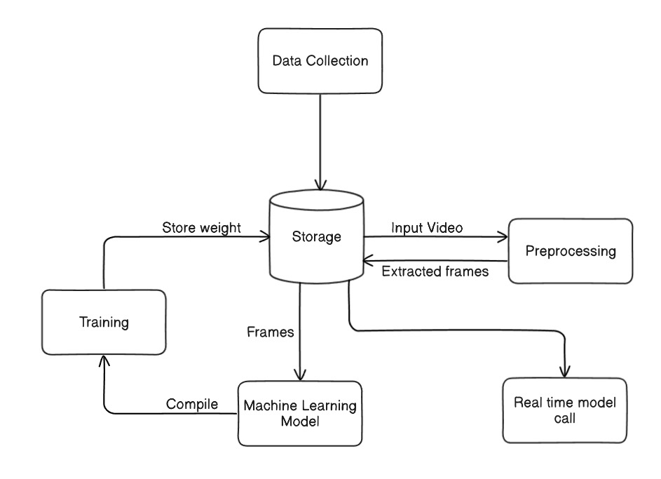






Data Flow Diagram
Data Base

Slide 12
Functional Test Cases
Test Case | Description | Initial Result | Modifications & Fixes | Final Result
TC1: Dataset Preprocessing | Verify if the KOA-NM dataset is correctly loaded, structured, and split into train, validation, and test sets. | Failed (Some .MOV files were unreadable) | Converted .MOV files to .mp4, handled missing/corrupt files | Passed
TC2: Frame Extraction | Check if video files are correctly converted into frames for analysis. | Failed (Skipped frames, inconsistent FPS) | Adjusted frame extraction logic to maintain uniform FPS | Passed
TC3: Feature Extraction from Frames | Verify if extracted frames contain relevant joint movement information. | Failed (Blurred frames, missing keypoints) | Enhanced preprocessing with noise reduction and keypoint refinement | Passed
TC4: Pose Estimation | Check if OpenPose/Mediapipe can extract gait features from video input. | Passed | N/A | Passed
TC5: Model Training | Ensure the CNN-LSTM model successfully trains on the KOA dataset and achieves a minimum of 85% accuracy. | Failed (Accuracy was 78%) | Tuned hyperparameters, increased training epochs, and added data augmentation | Failed (OverFitting)
TC6: KOA Classification | Verify if the trained model correctly classifies gait into KOA severity levels. | N/A | N/A | N/A
TC7: Real-Time Prediction | Check if the model can process and classify a new gait video within 30 seconds. | N/A | N/A | N/A
TC8: Report Generation | Validate if the system generates an automated PDF report with severity level, gait heatmaps, and treatment suggestions. | N/A | N/A | N/A

Slide 13
IMPACT AND FUTURE WORK:
1) This analysis can serve as a diagnostic tool for healthcare professionals to monitor recovery progress in knee arthroplasty patients.
2) Future improvements could include adding more diverse datasets, refining the model, or integrating real-time monitoring for clinical applications.
Final Thought:
The integration of AI and machine learning into healthcare can provide valuable insights into patient recovery and help in optimizing rehabilitation strategies.

Slide 14
RESULT
Class | Precision | Recall | F1-Score | Support
NM (Normal) | 0.74 | 0.43 | 0.54 | 3389
KOA | 0.84 | 0.95 | 0.89 | 4244
Accuracy |  |  | 0.82 | 5633
Macro Avg | 0.79 | 0.69 | 0.72 | 5633
Weighted Avg | 0.81 | 0.82 | 0.80 | 5633

Slide 15
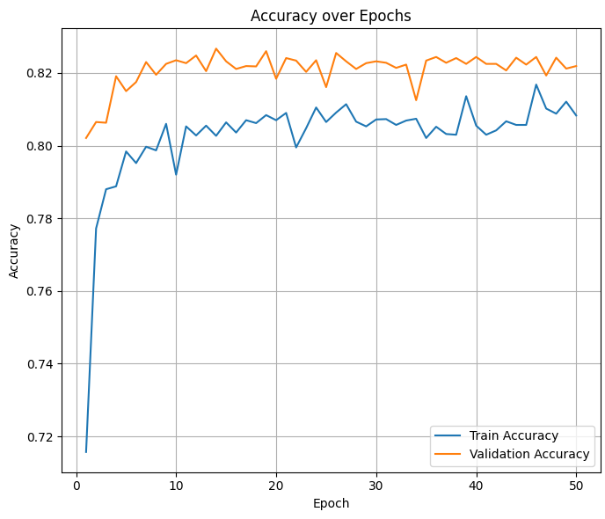
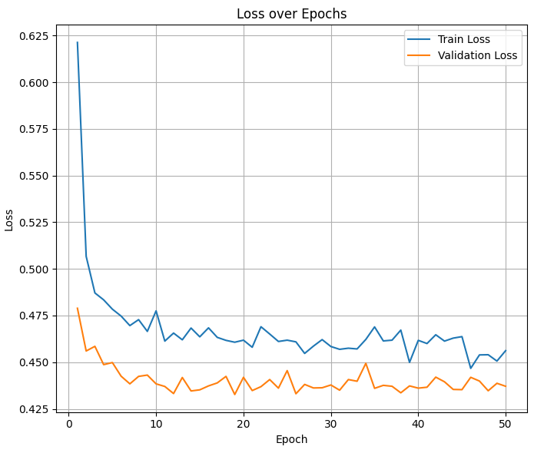
GRAPHS

Slide 16
CONCLUSION
Objective Recap:
The project aimed to analyze knee Osteoarthritis using video-based gait analysis through an LSTM model, focusing on different recovery stages: Normal, Early, Mid, and Severe.
Key Findings:
The model successfully classified gait patterns into the four predefined stages.
Significant progress was observed in the model's ability to detect nuances in gait changes over time.
The use of LSTM helped in capturing the temporal dependencies in movement, leading to more accurate predictions.

